Slide 1
Software Testing (Unit Testing)

Slide 2






About me
Graduated from
Working for 7+ years at
Take part as GeekHub lecturer for 2 seasons
Fan of and programming language
Follow TDD and Clean Code principles
Find me at https://github.com/vrudas

Slide 3
Lesson goals
What is code testing
Why we need it
How to write tests
Tests and Mocking
Code coverage
Testing methodologies

Slide 4
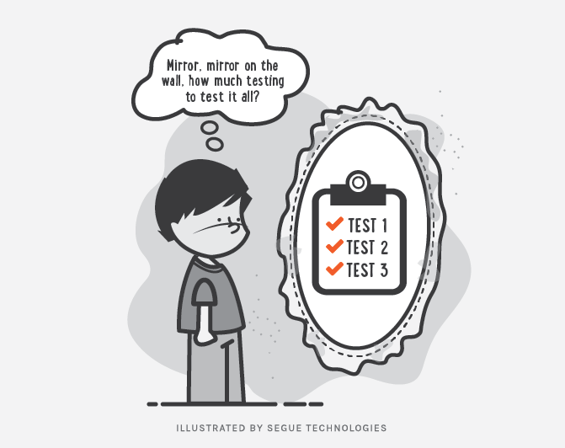
Code Testing

Slide 5
Problem
Scenario : “Let’s make a small fix!!!”

Slide 6
Problem
Scenario : “Let’s make a small fix!!!”
Action: Developer changes a “simple” line of code.

Slide 7

Problem
Scenario : “Let’s make a small fix!!!”
Action: Developer changes a “simple” line of code.
Result: This quick fix solve the problem but broke other parts of the program 😈
Tacoma Bridge Collapse

Slide 8
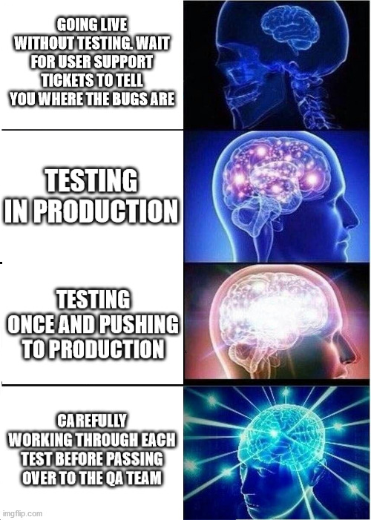
Solution – Always Test Your Code

Slide 9
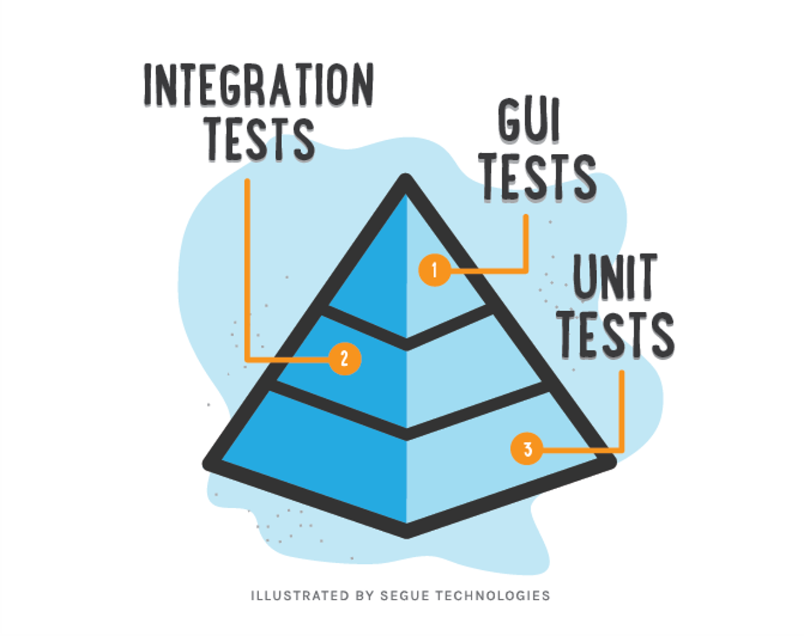
Testing levels aka “Testing Pyramid”
Manual Testing
$$$$
$

Slide 10
Unit testing

Slide 11
Unit Test Example
class Calculator {
int add(int x, int y) {
return x + y;
}
}
public class CalculatorTest {
@Test
public void adding_two_numbers() {
Calculator calculator = new Calculator();
int actualResult = calculator.add(1, 2);
int expectedResult = 3;
assertEquals(actualResult,expectedResult);
}
}

Slide 12
Pros vs Cons
Bugs preventing
Easy refactoring
Better code architecture
Documentation
Less debugging cases
Time saver
Money saver
Must have practice for big projects
Guarantee that your code is working as expected

Slide 13
Pros vs Cons
Bugs preventing
Easy refactoring
Better code architecture
Documentation
Less debugging cases
Time saver
Money saver
Must have practice for big projects
Guarantee that your code is working as expected
Needs more time for first coding
Require support
Possible overhead
Quality tests require strong programming skills
Human factor
Not all errors can be detected (since every module it tested separately and later different integration bugs may appear)

Slide 14
How to setup & run tests
Setup:
Add test library to project
Run:
Directly from IDE (mostly used by devs)
Via build system (Gradle task verification::test)
CI server to assure that nothing was broken

Slide 15


Testing libraries

Slide 16

Working with IDE

Slide 17
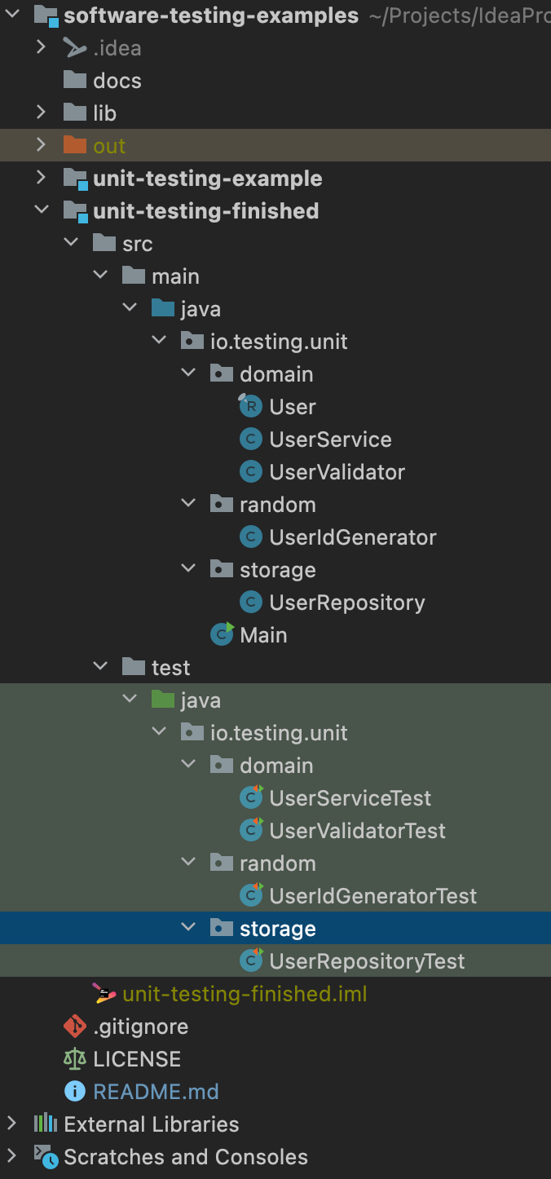
Test Source code convention

Slide 18
Code Convention in Tests
Test of class should be in same package in test source root
Tested class should have same name as tested class with suffix “Test”
Feature to be tested
Should_ExpectedBehavior_When_StateUnderTest
When_StateUnderTest_Expect_ExpectedBehavior
One convention for all tests

Slide 19
Tested method names patterns
Feature to be tested
IsNotAnAdultIfAgeLessThan18
FailToWithdrawMoneyIfAccountIsInvalid
StudentIsNotAdmittedIfMandatoryFieldsAreMissing

Slide 20
Tested method names patterns
Should_ExpectedBehavior_When_StateUnderTest
Should_ThrowException_When_AgeLessThan18
Should_FailToWithdrawMoney_ForInvalidAccount
Should_FailToAdmit_IfMandatoryFieldsAreMissing

Slide 21
Tested method names patterns
When_StateUnderTest_Expect_ExpectedBehavior
When_AgeLessThan18_Expect_isAdultAsFalse
When_InvalidAccount_Expect_WithdrawMoneyToFail
When_MandatoryFieldsAreMissing_Expect_StudentAdmissionToFail

Slide 22
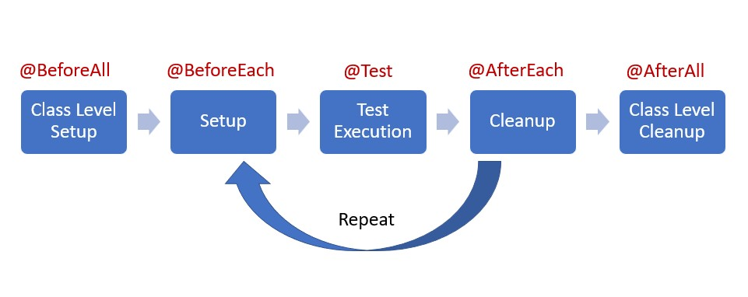
Test Lifecycle Phases
LifecycleExampleTest.java

Slide 23
Test results verification
assertEquals(Object o1, Object o2)
assertNotEquals(Object o1, Object o2)
assertTrue(boolean condition)
assertFalse(boolean condition)
assertNull(Object o)
assertNotNull(Object o)

Slide 24
Which code should be tested by Unit tests?
Yes
Business logic
Everything that contain conditions
No
Working with file system or DB
Working with some external services or internet

Slide 25
What you should not test
Other frameworks or libraries
Trivial code like “get/set”
Code that has non deterministic results* (Think random numbers)

Slide 26
Practice with User credentials validation

Slide 27
What is a good Unit test
Fast
Independent(Isolated)
Repeatable
Self-validating(execution result is true of false)
Timely
Incremental
Easy to understand
Easy to run
Test single unit
Maintainable
Informative (in case of fail)
Has one logical assertion

Slide 28
Good practices
Limit bounds test cases (especial for user input)
Reset components before each test
Test success cases and fail cases separately
Dependency injection through constructor

Slide 29
Mocking

Slide 30
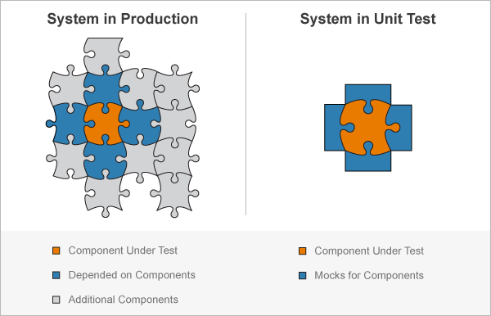
Mock Concept

Slide 31
Mock Types
Stub – do nothing
Mock – perform mocked operations
Spy – real object with mocked operations

Slide 32


Mocking libraries…

Slide 33
What is Mock ? (User service practice)

Slide 34
Argument matchers
any()
anyInt/String/etc()
any(Class c)
anyCollection/List/Set/Map()
eq()
More in class “org.mockito.ArgumentMatchers‘

Slide 35
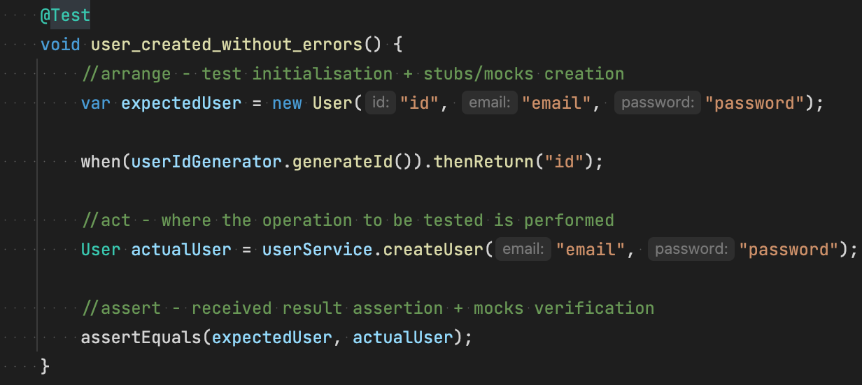
AAA (arrange, act, assert) or “given-when-then”

Slide 36

Code Coverage

Slide 37
Test Driven Development

Slide 38
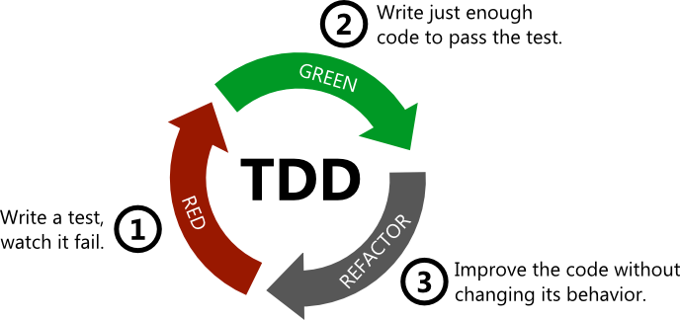
Test Driven Development

Slide 39
Useful links
Add custom Library to IDEA
Best practices for unit testing
The Pros & Cons of Test-Driven Development
7 Popular Unit Test Naming
Mockito Annotations

Slide 40
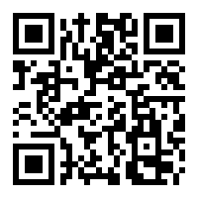
GitHub link for repository
https://github.com/vrudas/software-testing-examples

Slide 41

Thanks!
Any Questions?

